Slide 1

2022
School of Biotechnology
National Institute of Technology
Calicut
SUBMITTED BY:
Lakavath Rajendar (B191225BT)
Nived S (B190014BT)
Sanandh Kumar M (B191114BT)
Sarath P (B190522BT)
Under the Guidance of:
Dr. Ravindra Kumar (Assistant Professor, School of Biotechnology)
1

Slide 2

PROSTATE CANCER
Identification of Biomarker using mRNA Seq, miRNA and clinical data of Prostate Cancer using similarity network fusion, ML approach and survival analysis

Slide 3
Introduction
01
02
Why
What
03
How
Why Prostate Cancer Research?
Methodology of Identification of biomarker
How the identified Biomarker contribute to cancer treatment

Slide 4

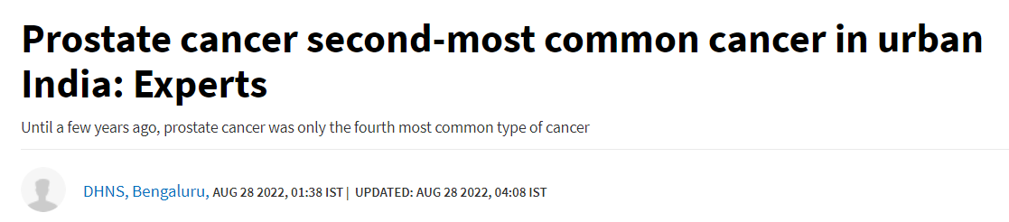


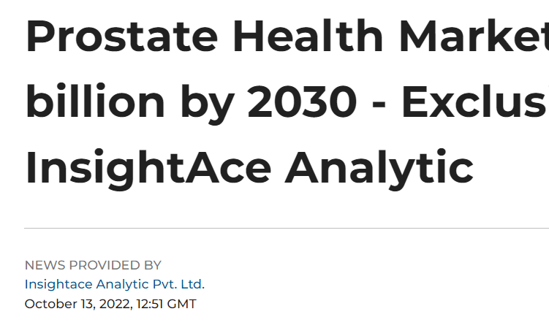

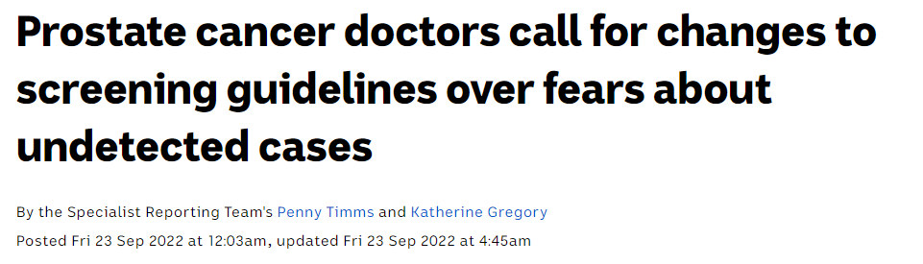
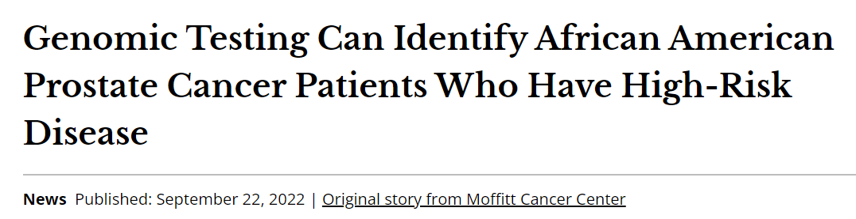
WHY ?
Prostate cancer is the 2nd most common cancer in men worldwide - Global Cancer Observatory (GCO)
Data Source : Ferlay J, Ervik M, Lam F, Colombet M, Mery L, Piñeros M, Znaor A, Soerjomataram I, Bray F (2020). Global Cancer Observatory: Cancer Today. Lyon, France: International Agency for Research on Cancer. Available from: https://gco.iarc.fr/today, accessed [15 March 2023].
4
Notes:
Prostate cancer (PCa) is the second most common cause of cancer and the sixth leading cause of cancer death among men worldwide. The worldwide PCa burden is expected to grow to 1.7 million new cases and 499 000 new deaths by 2030 simply due to the growth and aging of the global population

Slide 5
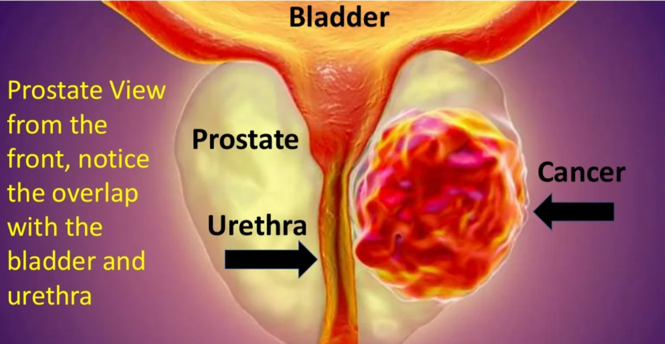
About The Disease
Prostate cancer is the most common malignant neoplasm of the urinary tract and most common non cutaneous cancer in men worldwide, with an estimated 1,600,000 cases and 365,000 deaths annually
Prostate cancer is a significant health concern in India, with an increasing incidence rate in recent years due to changing lifestyles and increasing life expectancy.
According to estimates, in 2023, there will be approximately 49,000 new cases of prostate cancer diagnosed in India.
Prostate cancer is also a global health issue. In 2023, it is projected that there will be around 1.4 million new cases of prostate cancer diagnosed worldwide.

Slide 6
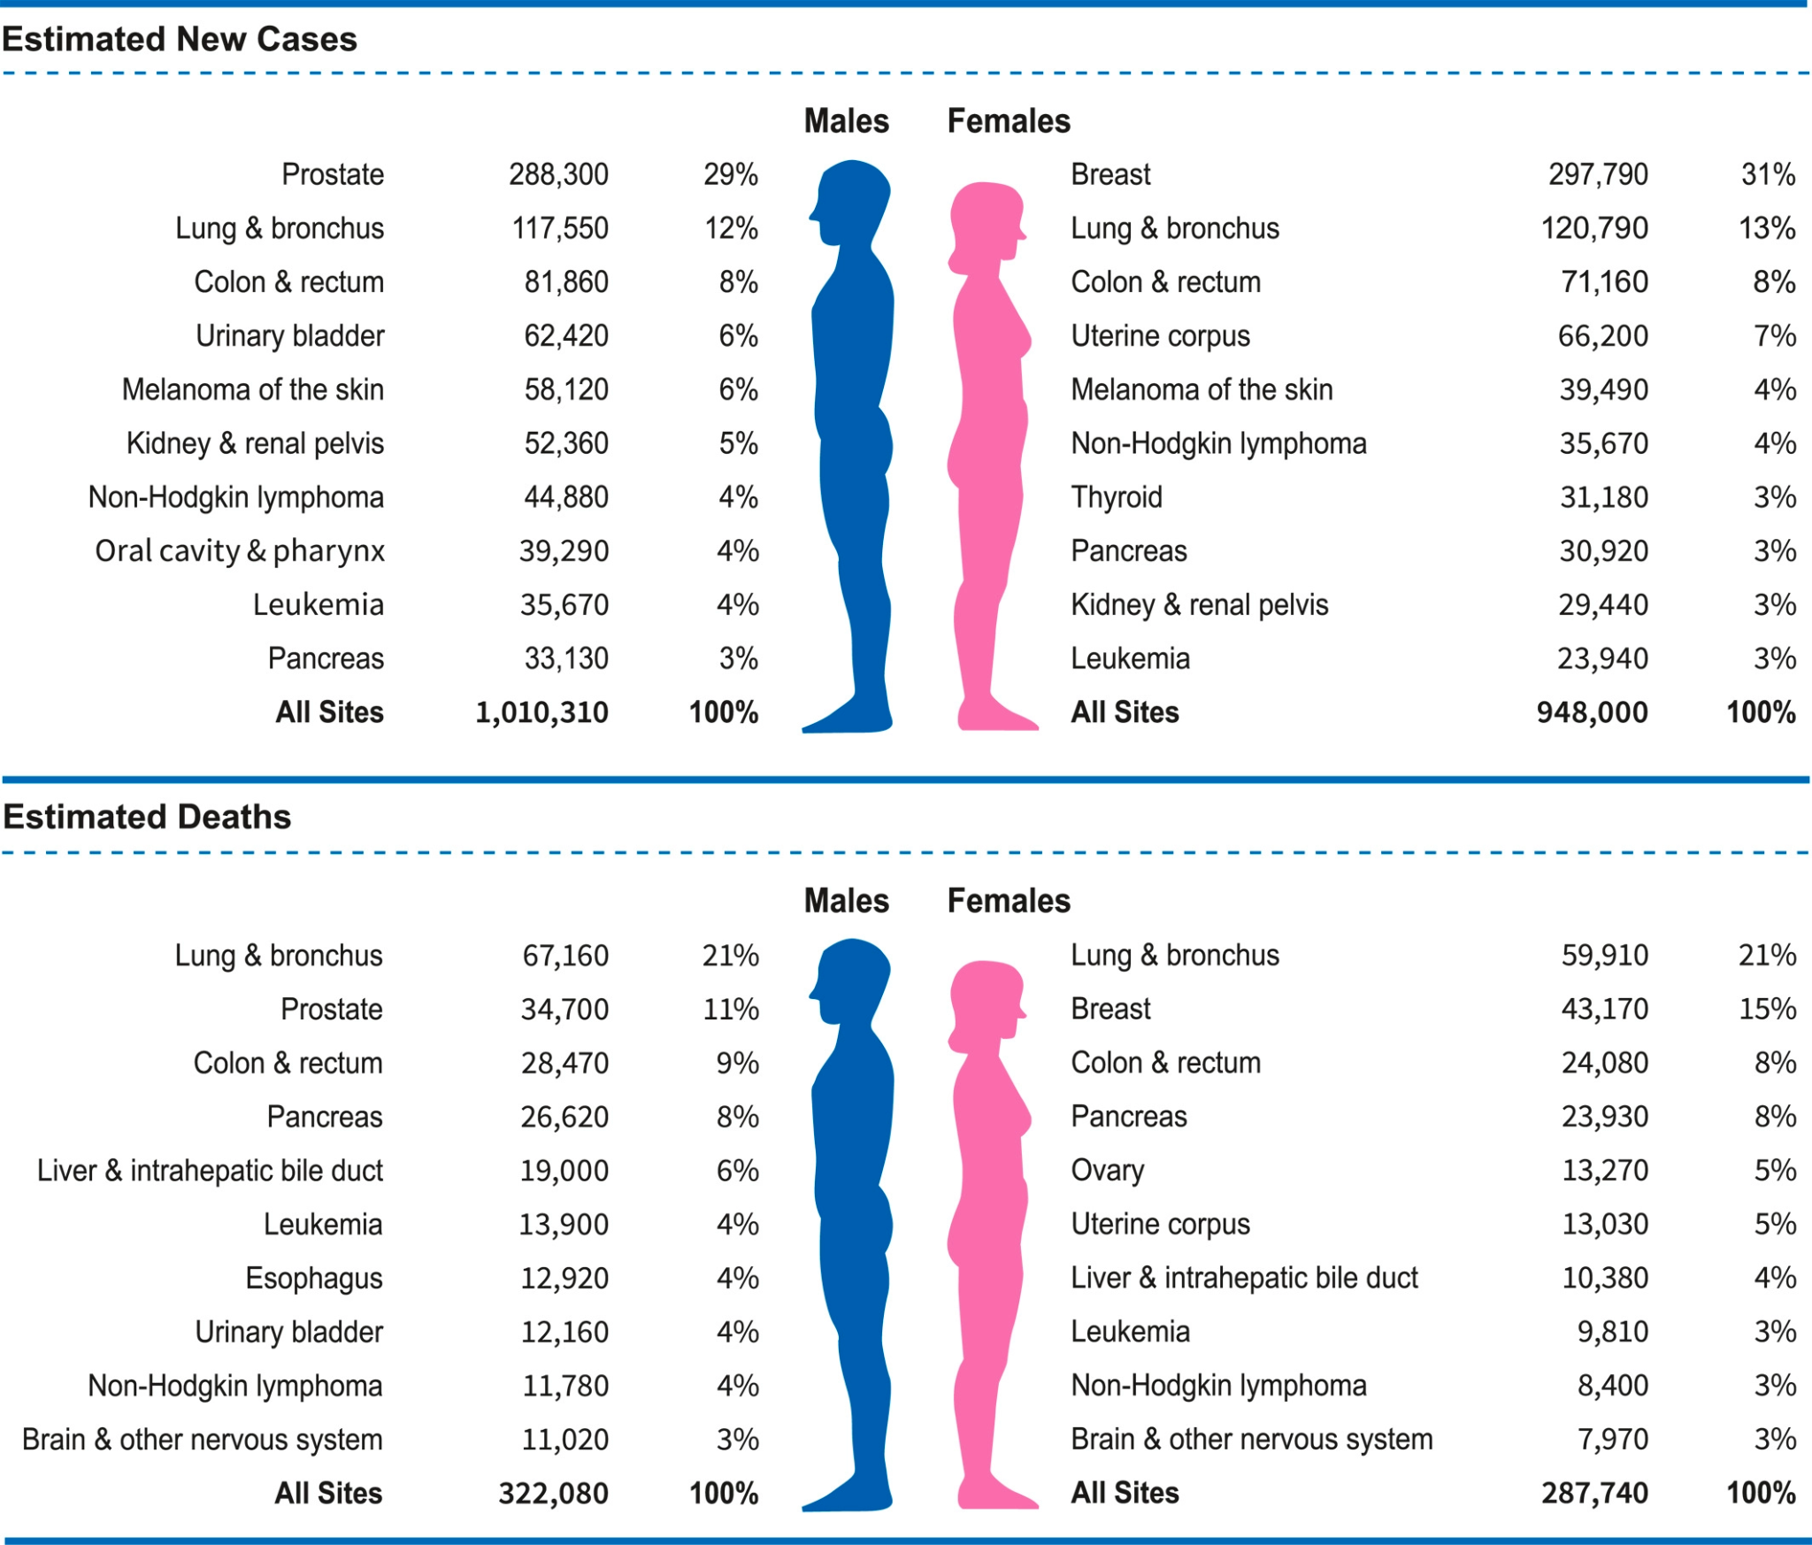
Cancer Statistics(ACS journal), Rebecca L. Siegel MPH et al, 2023

Slide 7
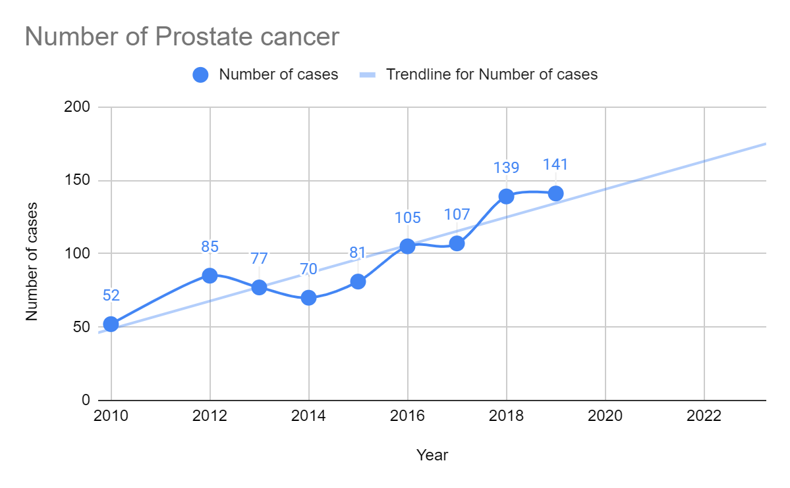
Prostate cancer - Kerala
The number of prostate cancer is in positive trend.
Based on report of Malabar Cancer Center, Thalassery
5

Slide 8
DIAGNOSIS
PSA Testing
DRE
TRUS
MRI Fusion Biopsy
Blood test that measures the amount of prostate specific antigen (PSA) in your blood.
Digital Rectal Examination
Transrectal Ultrasound
Combines the pictures from an MRI scan and an ultrasound to create a detailed 3-D image of the prostate.

Slide 9
IDEAL BIOMARKER
Should express early in disease expression
Capable of discriminating healthy from patients
Easy to assay, less expensive and should be helpful in reducing cancer deaths
Gives reproducible results and multiplexing is possible for screening purposes
Mukesh Varma et al, 2011

Slide 10
Research Workflow
Data Preprocessing : miRNA, mRNA & methylation data is taken from TCGA
Prostate Cancer Omics Data
Feature Importance : Machine learning feature importance models are used to identify important genes.
XGBoost Feature Importance
Lasso Feature Importance
ANOVA Feature Selection
Machine Learning Classification : ML classification models are used to verify accuracy of feature selection.
Common Genes
Machine Learning Classification
Pathway Analysis & Gene Ontology : To translate the list of genes that are differentially expressed across the given phenotypes.
Pathway Analysis
Gene Ontology
Survival Analysis
KEA & TFEA : To connect a set of genes with Transcription factors and Kinases
Kinase Enrichment Analysis
Transcription Factor Enrichment Analysis

Slide 11
Feature Importance
miRNA DATA
mRNA DATA
METHYLATION DATA
PPARGC1A - The PPARγ coactivator 1 alpha (PGC1α) is a prostate tumor suppressor that controls the balance between anabolism and catabolism. PGC1A downregulation in prostate cancer is causally associated with the development of metastasis.
ML Feature selection
ML Feature Selection
ML Feature selection
ML Classification on 12 miRNA
ML Classification on 37 mRNA
ML Classification on 38 Methylation points
MRNA Target to specific MiRNA
MRNA Target to Methylation points
90 Genes
37 Genes
20 Genes
Pathway Analysis

Slide 12
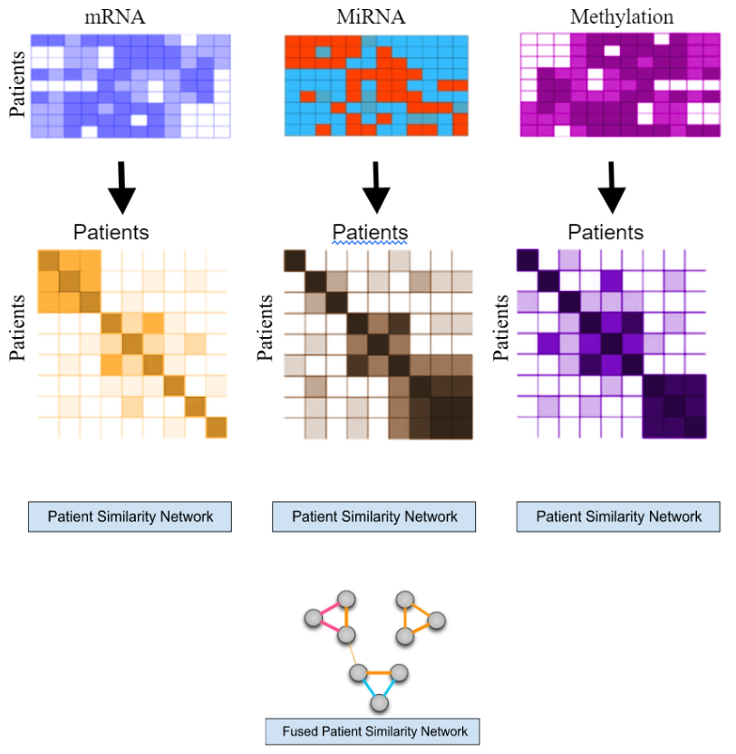
SNF
Similarity Network Fusion flowchart
Similarity Network Fusion (SNF) successfully identifies two distinct clusters after integrating mRNA, miRNA, and Methylation data, demonstrating the significant impact of multi-omics data integration on clustering outcomes.
Figure 1: Similarity Network Fusion Workflow

Slide 13
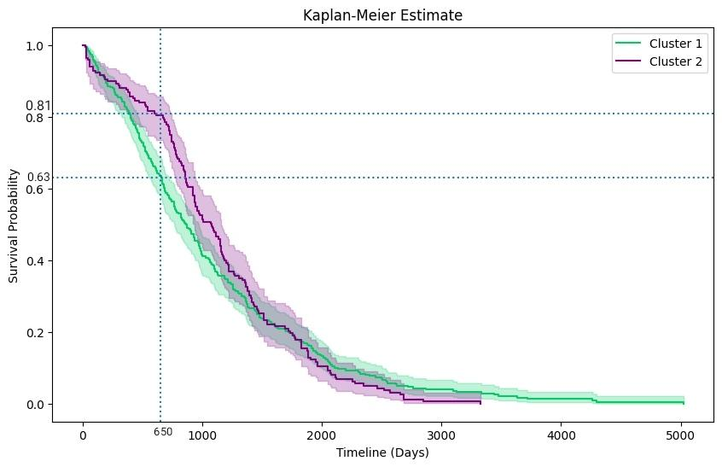
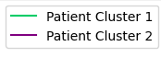
Similarity Network Fusion (SNF)
20

Slide 14
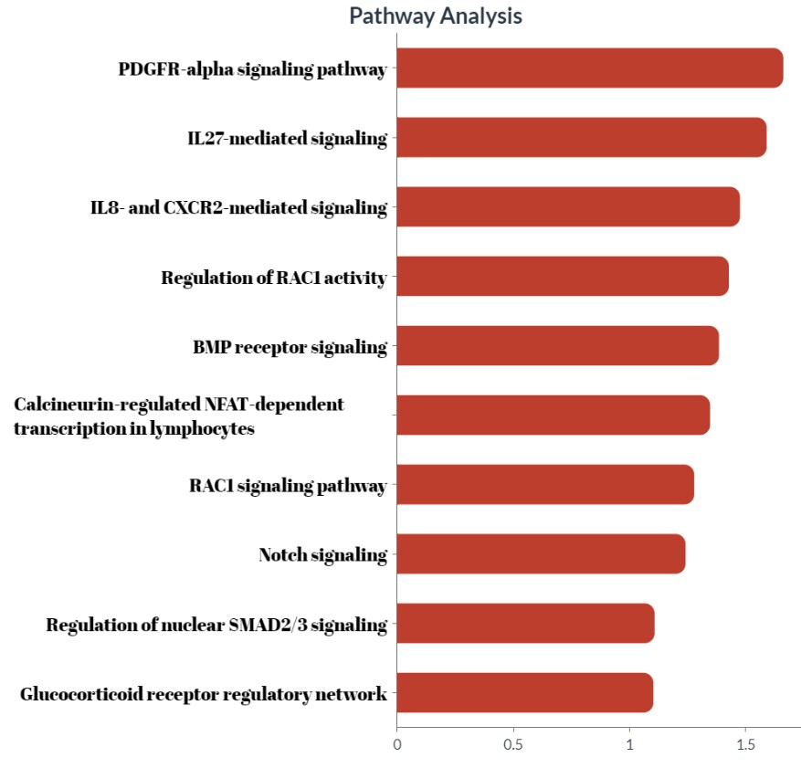
Figure 2: Pathway analysis report indicating significant pathway related to given Genes
-log(pvalue)

Slide 15
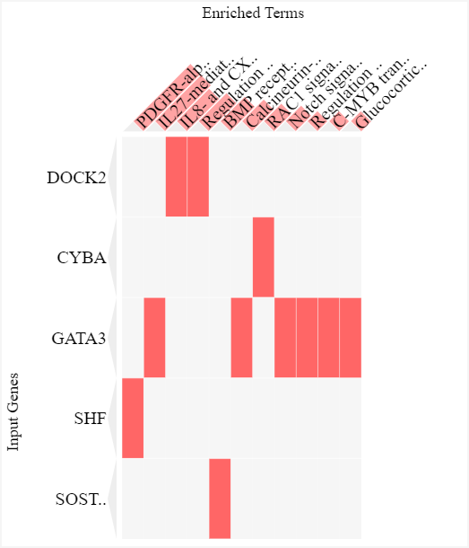
Figure 3: .Clustergram of Pathway Analysis

Slide 16
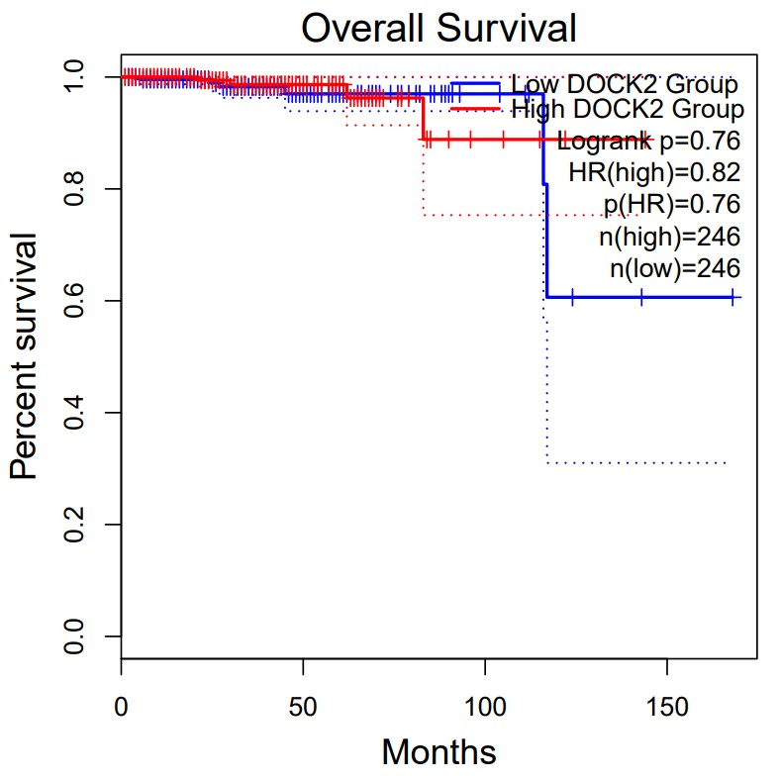
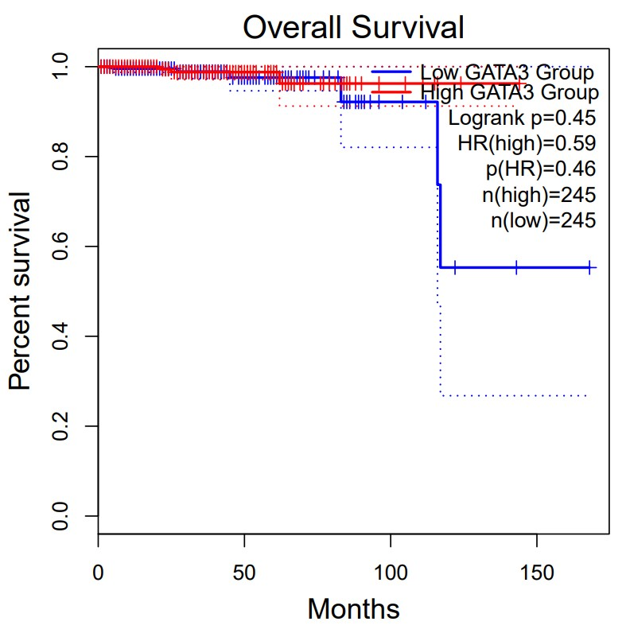
Figure 4: Survival analysis report indicating survival probability on given gene

Slide 17
Conclusion
HSP90B1, UBE2D2, PAK3, and RGL1 are identified as potential biomarker candidates based on survival analysis of genes from miRNA and mRNA datasets.
RGL1, MGA and RRM2 are identified as potential biomarker candidates as they are present on top three ontologies.
DOCK2 and GATA3 are found to exhibit potential tumor suppressor functions in advanced stages of tumor development, making them promising biomarkers for early detection and prognostication of malignancies.
Transcription factors AR, MAPK14, and FOS show differential expression and potential as biomarker candidates for early detection of prostate cancer.
PPARGC1A consistently emerges as a significant gene in both mRNA and miRNA datasets, indicating strong potential as a promising biomarker candidate.

Slide 18
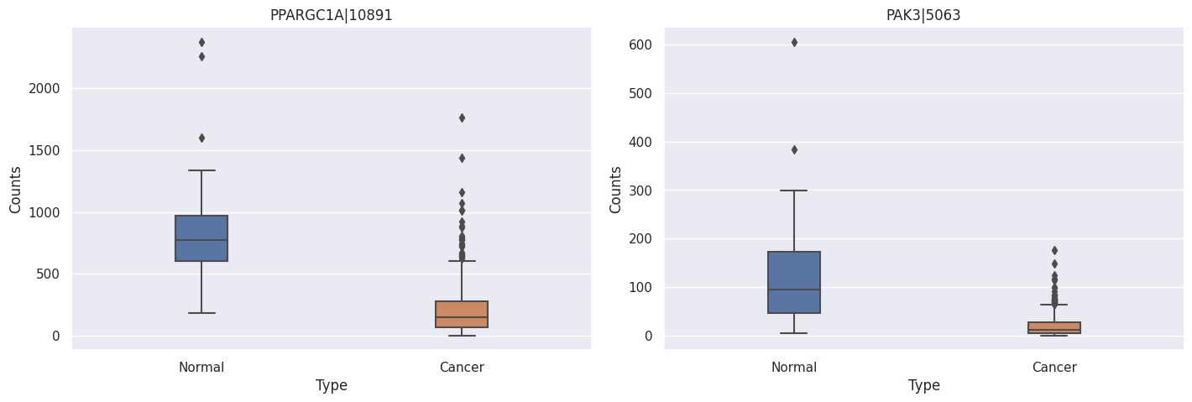
mRNA
Down regulated
Down regulated
Figure 5: Box plot of genes from mRNA

Slide 19
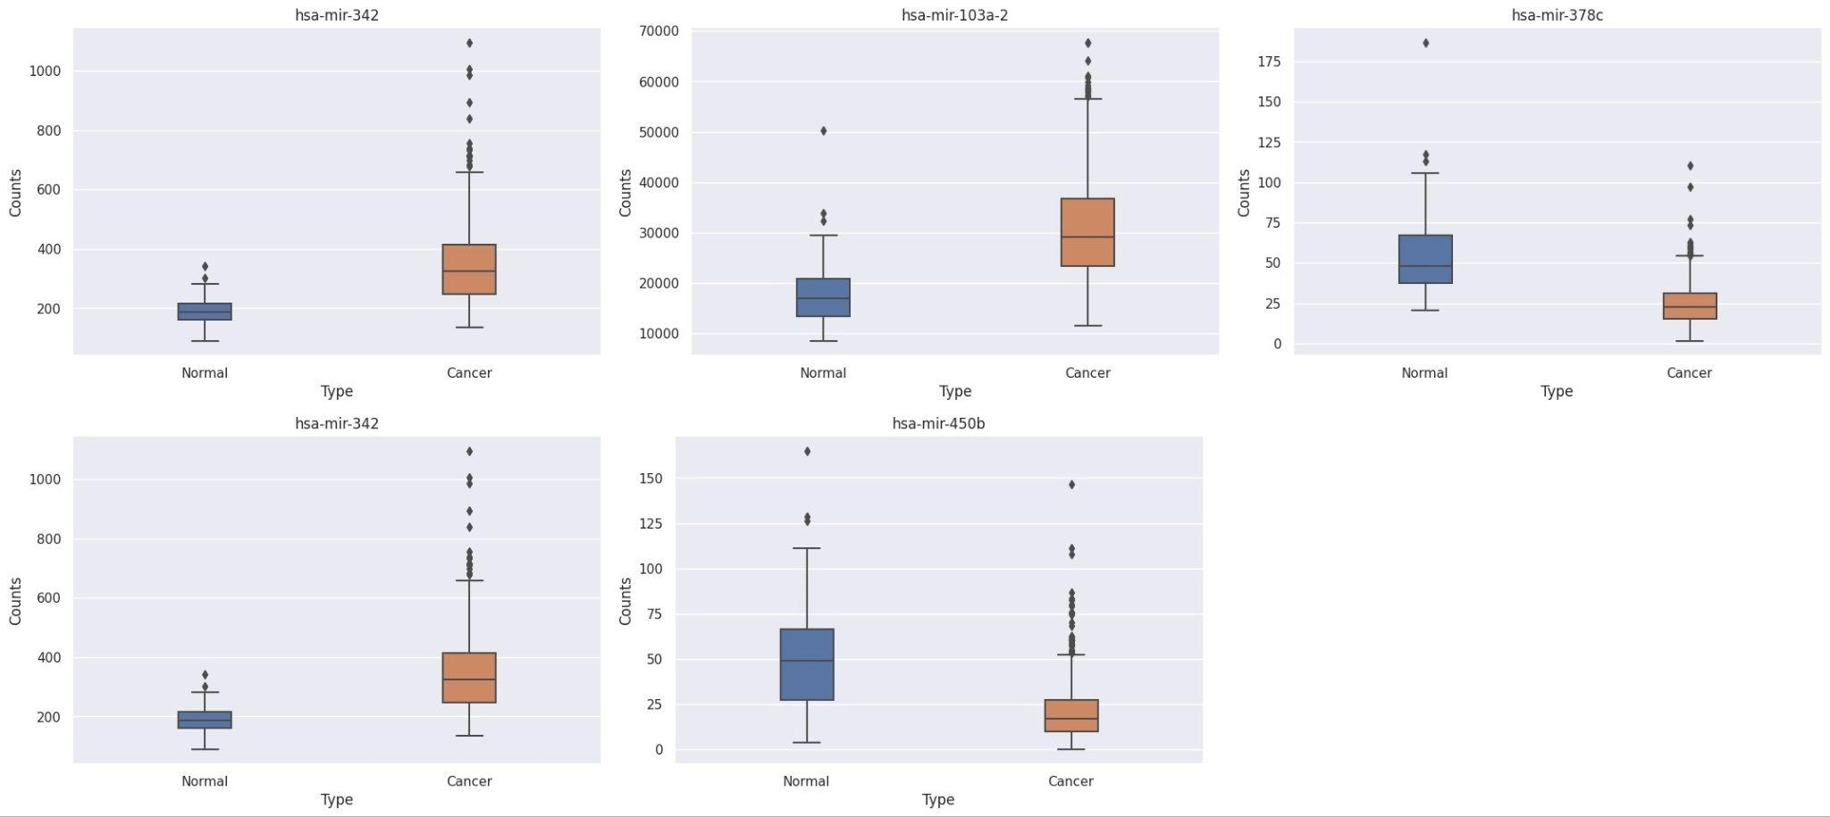
miRNA
Up regulated
Up regulated
Down regulated
Up regulated
Down regulated
Figure 6: Box plot of genes from miRNA

Slide 20
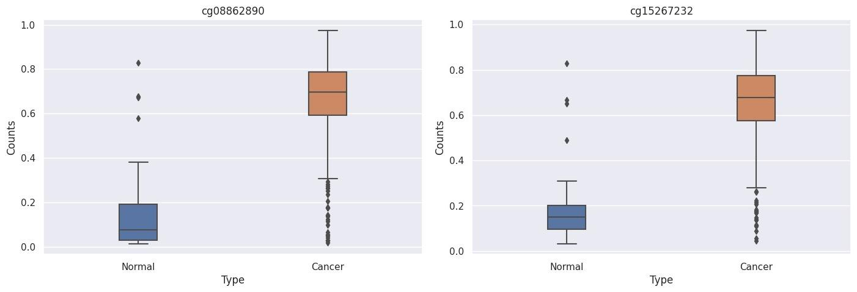
DNA Methylation
Up regulated
Up regulated
Figure 6: Box plot of genes from DNA Methylation

Slide 21
THANKS

Slide 22
REFERENCES
Wang X, Kruithof-de Julio M, Economides KD, Walker D, Yu H, Halili MV, Hu YP, Price SM, Abate-Shen C, Shen MM. 2009. A luminal epithelial stem cell that is a cell of origin for prostate cancer.[PMC free article] [PubMed]
Sizemore GM, Pitarresi JR, Balakrishnan S, Ostrowski MC. 2017. The ETS family of oncogenic transcription factors in solid tumours[Google Scholar]
Tomlins SA, Rhodes DR, Perner S, Dhanasekaran SM, Mehra R, Sun XW, Varambally S, Cao X, Tchinda J, Kuefer R, et al. 2005. Recurrent fusion of TMPRSS2 and ETS transcription factor genes in prostate cancer.[Google Scholar]
Chen EY, Tan CM, Kou Y, Duan Q, Wang Z, Meirelles GV, Clark NR, Ma'ayan A.
Enrichr: interactive and collaborative HTML5 gene list enrichment analysis tool. BMC Bioinformatics. 2013; 128(14).
Kuleshov MV, Jones MR, Rouillard AD, Fernandez NF, Duan Q, Wang Z, Koplev S, Jenkins SL, Jagodnik KM, Lachmann A, McDermott MG, Monteiro CD, Gundersen GW, Ma'ayan A.
Enrichr: a comprehensive gene set enrichment analysis web server 2016 update. Nucleic Acids Research. 2016; gkw377 .
Xie Z, Bailey A, Kuleshov MV, Clarke DJB., Evangelista JE, Jenkins SL, Lachmann A, Wojciechowicz ML, Kropiwnicki E, Jagodnik KM, Jeon M, & Ma’ayan A.
Gene set knowledge discovery with Enrichr. Current Protocols, 1, e90. 2021. doi: 10.1002/cpz1.90
Haffner J, Potiron E, Bouye S, Puech P, Leroy X, Lemaitre L, Villers A. 2009. Peripheral zone prostate cancers: location and intraprostatic patterns of spread at histopathology. [Google Scholar]
22

Slide 23
Sivaraman A, Bhat KRS. Screening and Detection of Prostate Cancer-Review of Literature and Current Perspective. Indian J Surg Oncol. 2017 [PMC free article]
Loriot Y, Massard C, Fizazi K. Recent developments in treatments targeting castration-resistant prostate cancer bone metastases. Ann Oncol. 2012[PubMed].
Tannock IF, de Wit R, Berry WR, Horti J, Pluzanska A, Chi KN, et al.2004 .Docetaxel plus prednisone or mitoxantrone plus prednisone for advanced prostate cancer. [PubMed]
McDonald, A. C., Vira, M. A., Vidal, A. C., Gan, W., Freedland, S. J., and Taioli, E. (2014). Association between systemic inflammatory markers and serum prostate-specific antigen in men without prostatic disease - the 2001-2008 National Health and Nutrition Examination Survey.
Belova, A. A., Sosnovtseva, A. O., Lipatova, A. V., Njushko, K. M., Volchenko, N. N., Belyakov, M. M., et al. (2017). Biomarkers of Prostate Cancer Sensitivity to the Sendai Virus. Mol. Biol. 51 (1), 80–88 .[Google Scholar]
Vinjamoori, A. H., Jagannathan, J. P., Shinagare, A. B., Taplin, M. E., Oh, W. K., Van den Abbeele, A. D., et al. (2012). Atypical metastases from prostate cancer [PubMed]
Plati, J., Bucur, O., Khosravi-Far, R. (2011). Apoptotic cell signaling in cancer progression and therapy.[PubMed]
Mukesh Varma, Payal Patel, Mudit Verma(2011). Biomarkers in Prostate Cancer Epidemiology[PubMed]
23

